Slide 1
E‑Commerce Customer Analysis Report
By Munirat Lawal

Slide 2
INTRODUCTION
This presentation provides a data driven analysis of our eCommerce platform, focusing on three key areas:
Customer Insights – Understanding who our customers are, their demographics, and purchase behaviours.
Sales Performance – Analysing revenue trends, top performing products, and the effectiveness of payment methods.
Customer Behaviour & Retention – Evaluating engagement patterns, session behaviour, repeat purchases, and factors affecting order value.
Key Metrics
Total Revenue 22.97M
Total Amount Spent 21.78M
Average Order Value 1.35K
Average Discount 69.79
Total Customers 5,000
Avg. Session Duration 14.54 mins
Total Pages Viewed 153K
Returning Customer Rate 11.88%

Slide 3
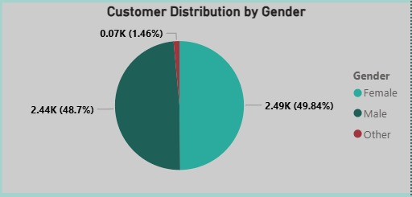
Customer Insight
Customer Distribution by Gender
The customer base is almost evenly split between female (49.84%) and male (48.7%) customers.
This balance shows that the business appeals to both genders equally, indicating broad market reach.
A very small segment (1.46%) identifies as Other, showing minimal representation but still worth acknowledging for inclusivity.
Marketing strategies can be designed to target both male and female customers effectively, as neither group dominates the customer population.

Slide 4
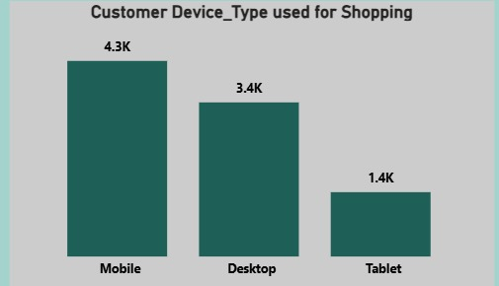
Customer Insight
Device Type Usage
Mobile users dominate, showing customers prefer shopping on their phones.
Desktop and tablet usage is significantly lower, suggesting optimization should focus on mobile UI/UX.
Mobile-friendly campaigns will likely perform better.

Slide 5
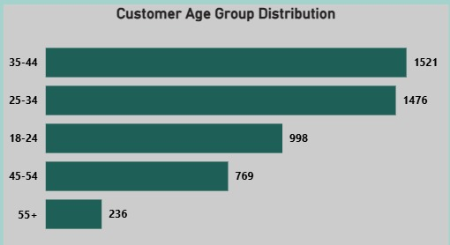
Customer Insight
Customer Age Distribution
The dashboard shows that middle-aged customers (35–44) make up the largest customer segment.
Younger customers (18–25) and older customers (55+) contribute much less, indicating a concentrated target demographic.
Marketing efforts should prioritize the dominant age group while improving engagement with younger and older customers.

Slide 6
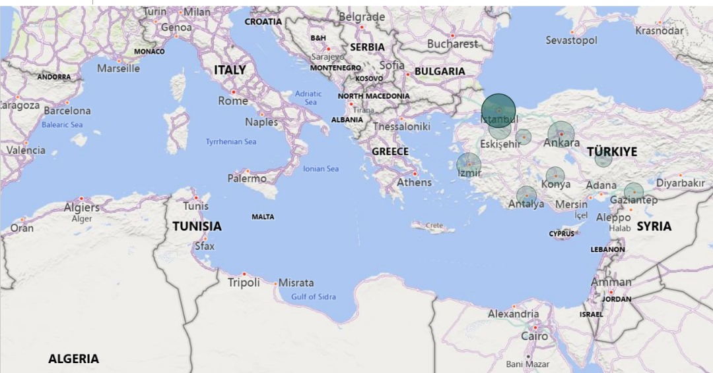
Customer Insight
Customer Distribution by City
Istanbul has the highest number of customers, making it the core customer hub for the business.
Ankara and Izmir follow as strong secondary markets, showing solid customer presence and engagement.
Mid-tier cities like Bursa, Antalya, Gaziantep, and Adana show moderate customer activity, offering opportunities for targeted growth.
Smaller cities such as Konya, Kayseri, and Eskisehir contribute less, suggesting lower market penetration and potential areas for expansion.
Overall, customer distribution is heavily concentrated in major metropolitan areas, indicating that urban-focused marketing strategies will yield the best results.

Slide 7
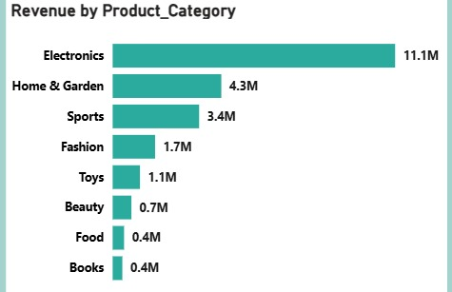
Sales Performance
Top Product Categories
Categories like Electronics, Fashion, and Home & Garden generate the highest sales.
These categories are the company’s revenue pillars and should receive continued investment in marketing and inventory planning.
Lower performing categories may require promotions or bundling strategies.

Slide 8
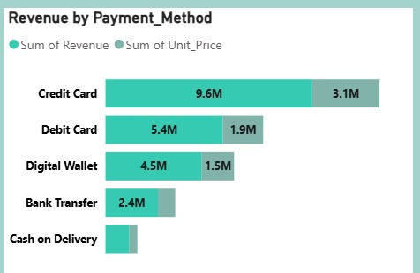
Sales Performance
Revenue by Payment Method
The chart shows that Credit/Debit Card payments generate the highest share of total revenue, indicating that most customers prefer traditional card-based transactions.
Digital Wallets (such as PayPal or mobile wallets) contribute a moderate but growing portion of revenue, showing increasing adoption of fast and convenient payment options.
Bank Transfers and other methods contribute the lowest revenue, suggesting they are less popular due to longer processing times or lower convenience.
Overall, the business relies heavily on card payments, but the rise in digital wallet usage presents an opportunity to promote faster checkout and mobile-friendly payment experiences.

Slide 9
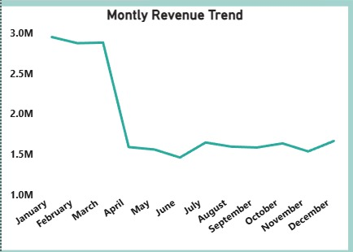
Sales Performance
Monthly Revenue Trend
Revenue is very high from January to March, staying close to 2.9M–3M.
There is a sharp drop in April, where revenue falls to around 1.5M.
From April to December, revenue remains stable but low, fluctuating between 1.4M and 1.6M.
The business performs much stronger in Q1 compared to the rest of the year, indicating seasonal demand or a need to boost sales in later months.

Slide 10
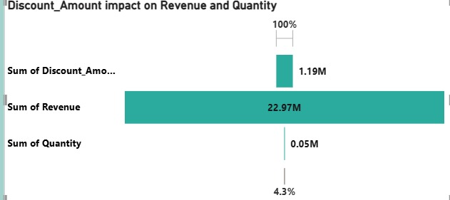
Sales Performance
Discount Amount Impact on Revenue and Quantity
Total discounts given: 1.19M, which helped generate 22.97M in revenue.
Discounts also increased product movement: 50K items sold.
The percentage indicator (4.3%) suggests that even a relatively small discount investment drives a strong revenue return.
Discounts are effective at boosting both sales volume and overall revenue, but should be monitored to avoid margin loss.

Slide 11
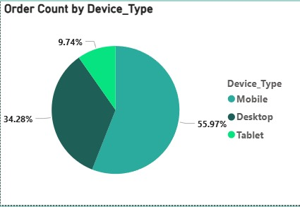
Sales Performance
Order Count by Device Type
Mobile accounts for the highest order share (55.97%), meaning most customers shop using their phones.
Desktop makes up about 34%, still important but much lower than mobile.
Tablet has the smallest share (9.74%).
This means the business should focus on mobile optimization, since it drives most orders.

Slide 12
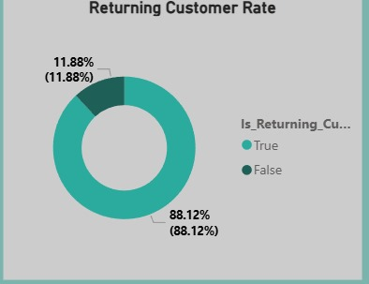
Customer behaviour and Retention
RETURNING CUSTOMER RATE
Only 11.88% of customers return, while 88.12% are one-time buyers.
Retention is low, meaning most customers do not come back after their first purchase.
Loyalty programs, targeted marketing, and post-purchase engagement are needed to increase repeat sales.

Slide 13
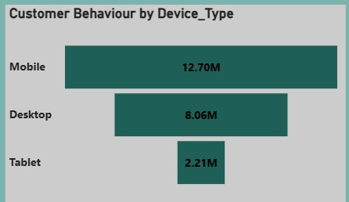
Customer behaviour and Retention
CUSTOMER BEHAVIOR BY DEVICE TYPE
Mobile users generate the highest revenue (12.7M).
Desktop users contribute 8.06M, and Tablets contribute 2.21M.
Mobile is the most valuable channel, reinforcing the need for mobile-first strategy.

Slide 14
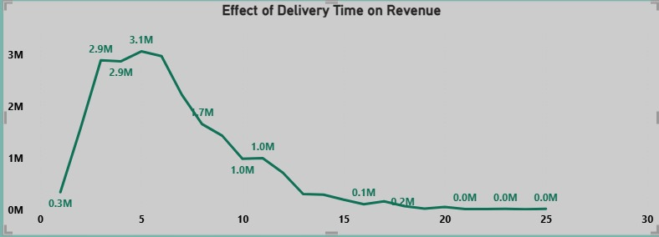
Customer behaviour and Retention
Effect of delivery time on revenue
Revenue is highest when delivery times are between 0 and 5 days.
As delivery time increases beyond 10 days, revenue drops sharply.
Faster delivery directly leads to higher sales improving logistics can significantly boost performance

Slide 15
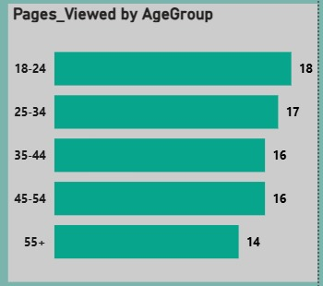
Customer behaviour and Retention
PAGES VIEWED BY AGE GROUP
Younger users (18–24) view the highest number of pages (18 pages).
Engagement gradually decreases with age, with the 55+ group viewing the fewest pages (14).
Younger customers explore more and show stronger browsing behavior.

Slide 16
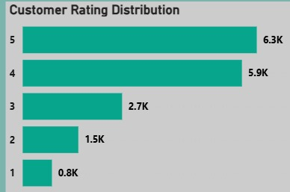
Customer behaviour and Retention
CUSTOMER RATING DISTRIBUTION
Most ratings are 4 and 5 stars, showing strong customer satisfaction.
Very few customers give low ratings (1–2 stars), indicating positive overall experience.
High ratings help strengthen customer trust and support repeat purchases.

Slide 17
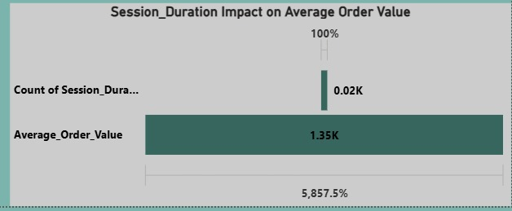
Customer behaviour and Retention
Session Duration Impact on Average Order Value
Customers who spend more time on the website tend to place higher-value orders.
Even though the count of long sessions is very small (0.02K), these users generate a much higher Average Order Value (AOV of 1.35K).
This suggests that engagement = money.
When customers stay longer, they explore more products and end up spending more

Slide 18
Conclusion
The data reveals strong performance across revenue and customer engagement, with clear behaviour patterns that can be optimized further.
High value customers are driven by longer session durations and effective discount strategies.
Certain payment methods deliver significantly higher revenue.
Customer demographics are well-balanced, but targeted campaigns can enhance conversions. Retention metrics signal opportunities to increase repeat purchases.
Recommendation
Strengthen marketing targeting based on gender, location, and customer segments
Optimize discount strategies to increase revenue without reducing profitability
Promote top-performing payment methods for smoother customer checkout
Enhance user experience to increase session duration and boost average order value
Implement loyalty or remarketing programs to improve retention

Slide 19
Thank you

